Slide 1
BAN 110 Project Presentation
GROUP (6) MEMBERS:
Anab Faiaz
Dhananjay Kumar
Lalith Joseph
Pranay Luhadia
Renita Dsouza
Mansi Bhanderi

Slide 2
Dataset and Task Description
The dataset is named New York City Airbnb Open Data. This data was taken from Kaggle.com
Dataset Description: Since 2008, visitors and hosts have utilized Airbnb to broaden travel options and provide a more distinctive, customized way of seeing the globe. This dataset represents the listing activity and metrics in New York City, NY in 2019.
For the purposes of this analysis, the following tasks will be carried out and illustrated throughout this report:
Data Characteristics
In the case of categorical variables, a frequency distribution of the possible values will be displayed. For numerical variables, a set of statistical attributes (min, max, and mean) will be displayed along with generated histograms.
Categorical Variables
Errors will be checked and corrected, as necessary. Missing values will also be noted & fixed accordingly. Derived variables will be created by combining the values in a specific categorical variable.
Numerical Variables
As stated for categorical variables, errors will be corrected, along with the removal of outliers. Normality will be tested by generating histograms and QQ plots for a variable with a skewed distribution.
Finally, a transformation will be applied before testing for normality again with a histogram & QQ plot.

Slide 3
Sl. No. | Variable | Significance | Type
1 | id | Listing identifier, unique to every Airbnb | Numerical
2 | name | Name of the Airbnb listing | Character
3 | host_id | Unique identifier for the host of the Airbnbs | Numerical
4 | host_name | Name of the host | Character
5 | neighbourhood_group | Location of the Airbnb listing, named by city | Character
6 | neighbourhood | Location of the Airbnb listing, named by neighbourhood | Character
7 | latitude | Latitude coordinates of the Airbnb listing | TBD
8 | longitude | Longitude coordinates of the Airbnb listing | TBD
9 | room_type | Specifies the kind of lodging - whether it’s the entire house/apartment, a private room, or a shared space | Categorical
10 | price | Price per day of the Airbnb listing, specified in dollars | Numerical
11 | minimum_nights | The minimum number of nights required for a booking to be accepted for thor Airbnb listing | Numerical
12 | number_of_reviews | Number of reviews uploaded for this Airbnb listing | Numerical
13 | last_review | Date of the latest review for the Airbnb listing | Date
14 | reviews_per_month | The average number of reviews submitted per month for this Airbnb listing | Numerical
15 | calculated_host_listings_count | The number of Airbnb listings recorded under this host | Numerical
16 | availability_365 | The number of days per year when this particular Airbnb is available for lodging | Numerical

Slide 4
Errors:
Categorical:
We found that Brooklyn was spelt in lowercase for some of the observations.
We found the missing in some of the character variables and deleted them.
We created a derived variable to categorise one of the variable.
Numerical:
We found extreme observations & outliers and corrected them using interquartile range method.
We found missing values in one of the variables i.e. Date and deleted them.

Slide 5
Data Characteristics In this step, we’ll be running two tests, depending on whether the variable is numerical or categorical. For the former, histograms will be generated, and a certain set of statistics will be rendered. For categorical variables, a simple frequency distribution will be created.

Slide 6
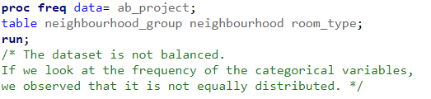

Categorical Variable
Numerical Variable

Slide 7
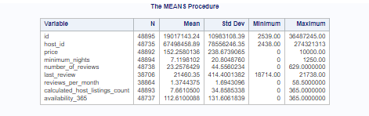
Means Procedure

Slide 8
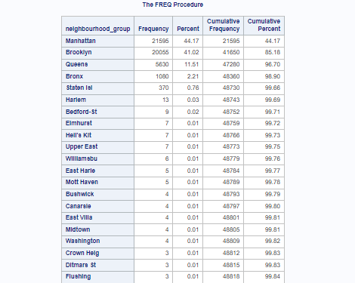
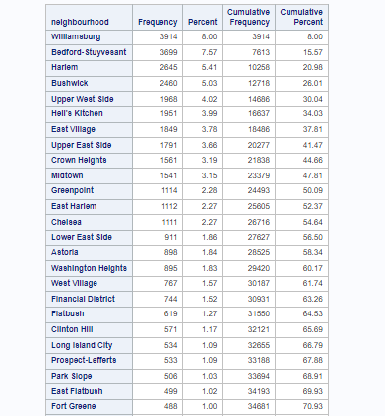


Slide 9
Interpretation
Variable | Description
Price | - This shows the price of a particular Airbnb listing. -The Minimum price is 0 and the maximum price is 10,000 -The mean is 152.253
Reviews Per Month | -This shows the reviews given by customers to each month to the host -The minimum reviews is 0 and the maximum reviews is 58.50 -The mean is 1.374
Neighbourhood | - This shows the location of the Airbnb - Top 5 neighbourhoods contains most number of listings.
Neighbourhood Group | - This shows the district in which the Airbnb is located. - top 4 districts contains most number of listings.
Room Type | - This shows the type of listing available. - More than 95% People prefer to stay in entire home and private room rather than shared room.

Slide 10
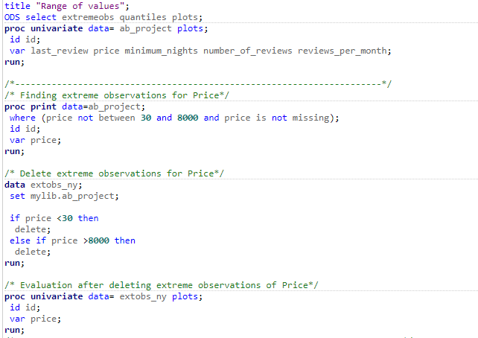
Numerical Variables

Slide 11
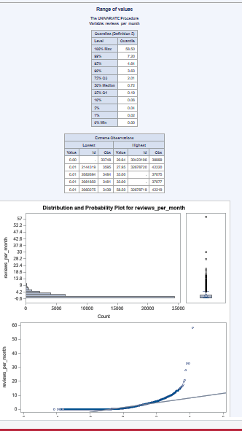
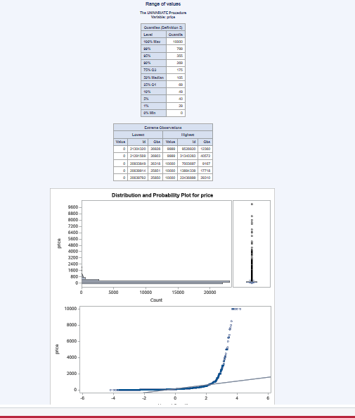

Slide 12
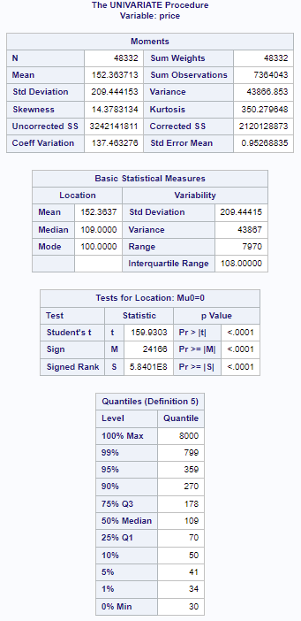
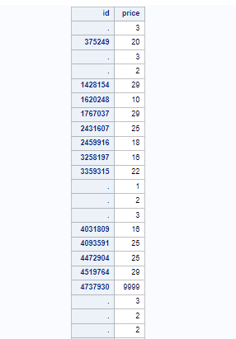
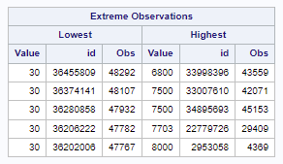

Slide 13
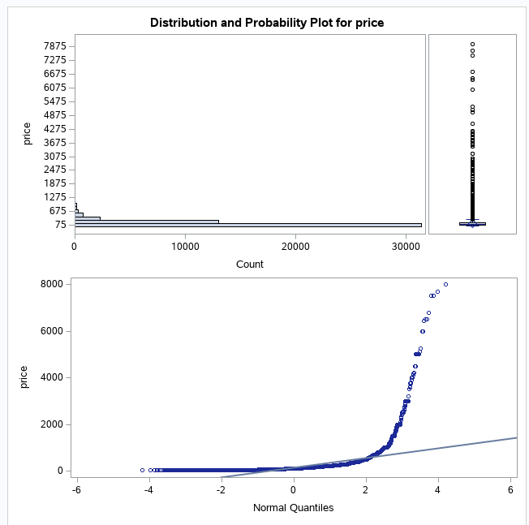

Slide 14
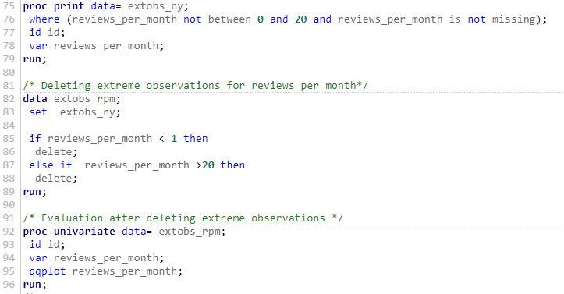
Reviews per month

Slide 15
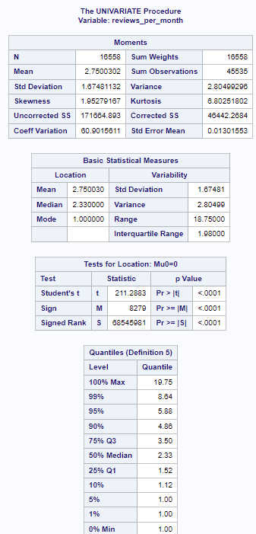
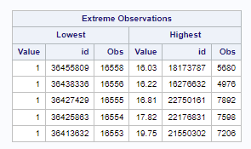

Slide 16
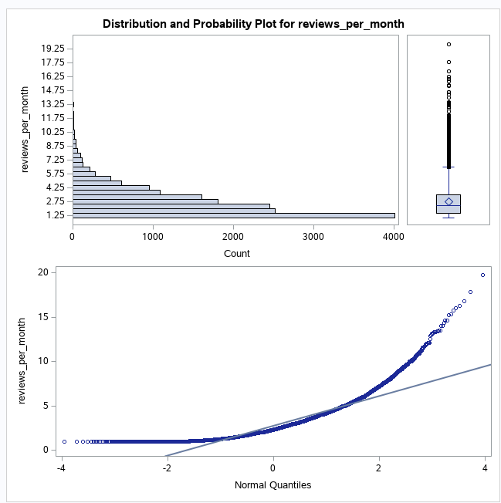

Slide 17
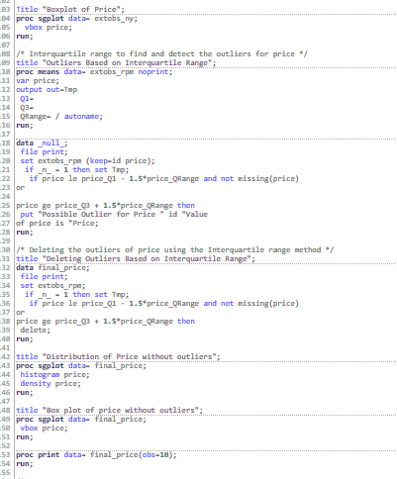
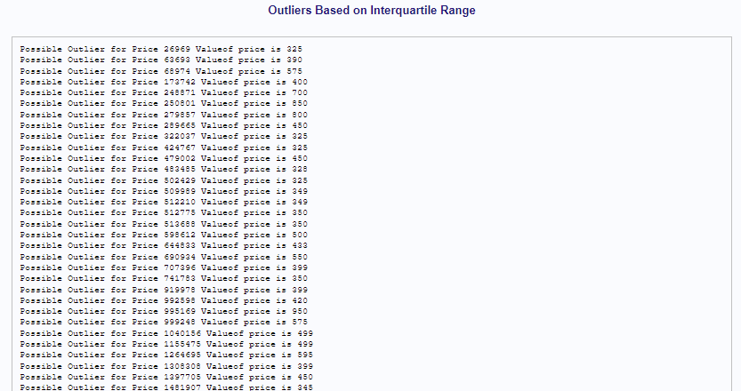
Outlier Detection price deletion

Slide 18
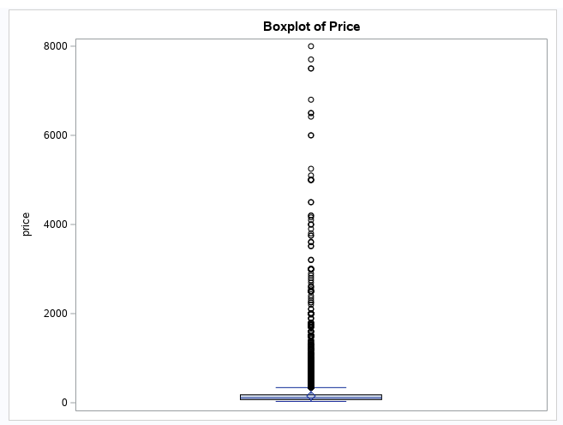

Slide 19
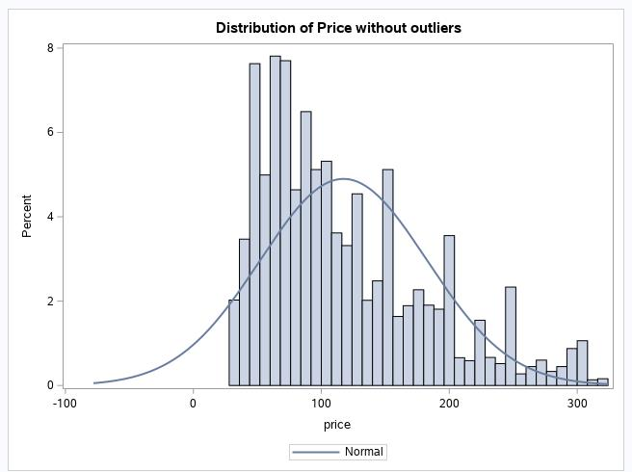
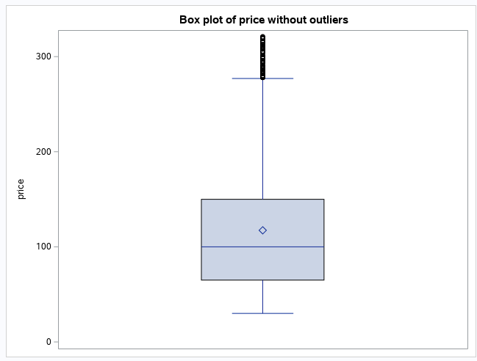

Slide 20
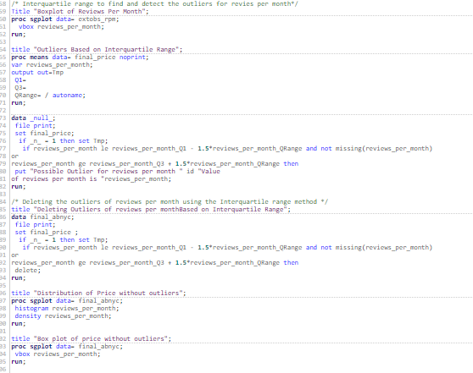
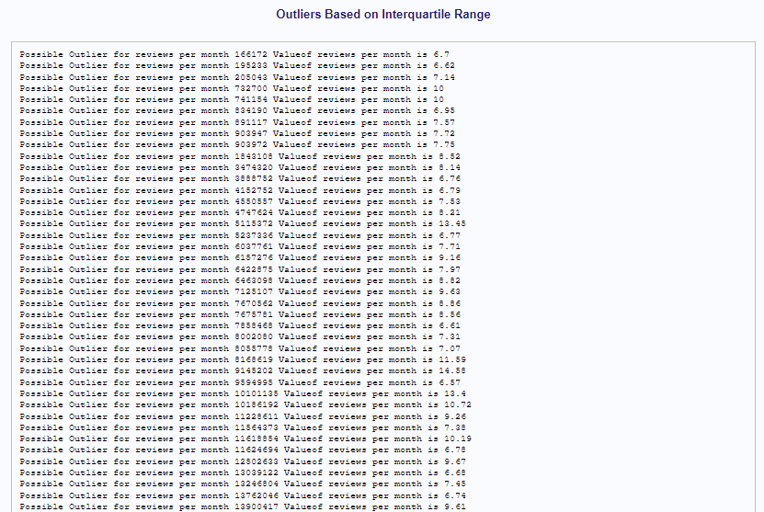
Review_per_month

Slide 21
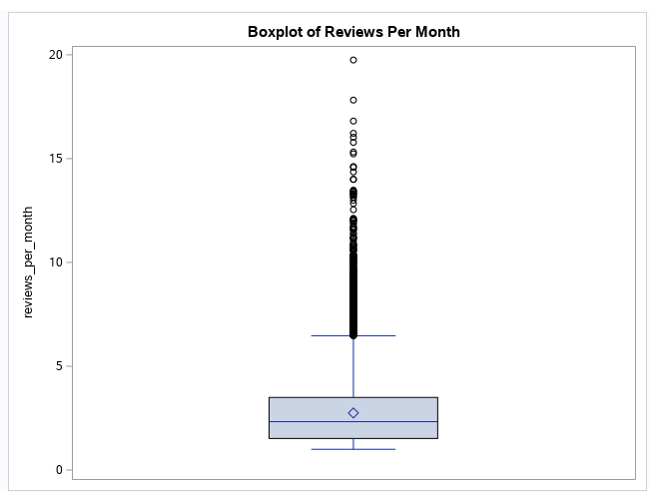

Slide 22
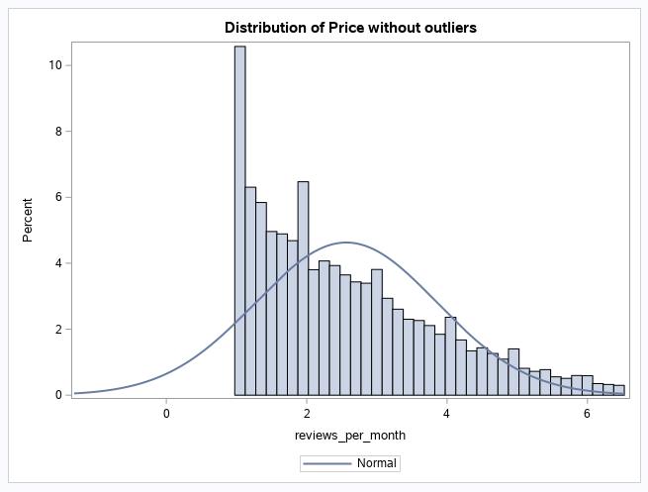
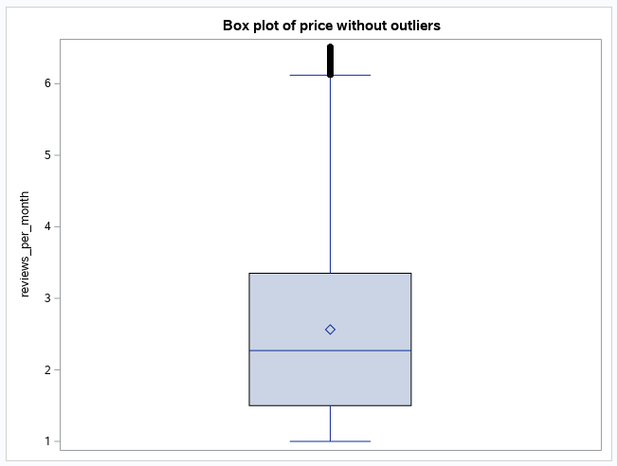

Slide 23

Testing normality for numerical

Slide 24
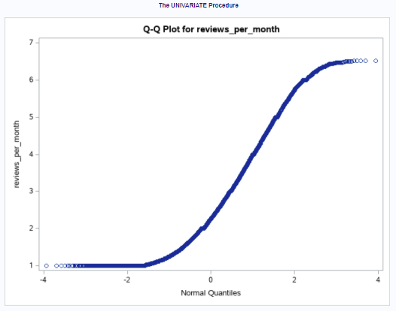
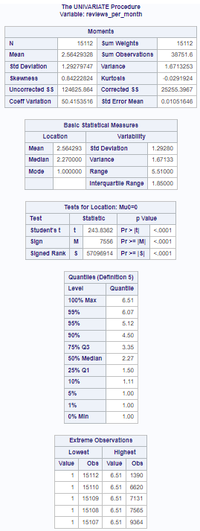

Slide 25
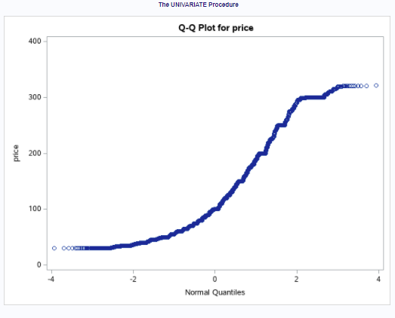
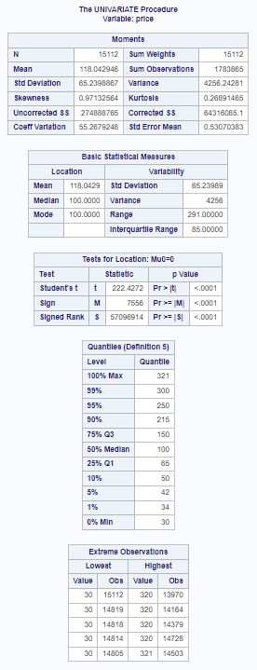

Slide 26
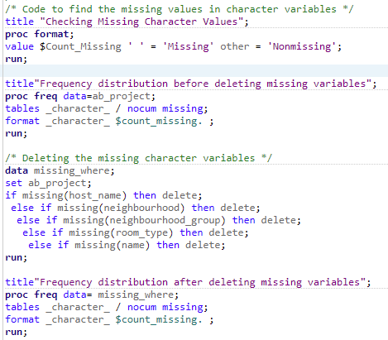
Categorical variables

Slide 27
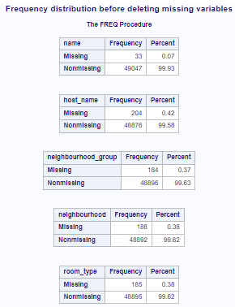
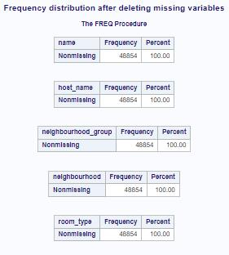
Result

Slide 28
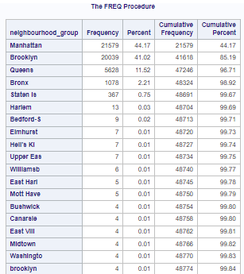
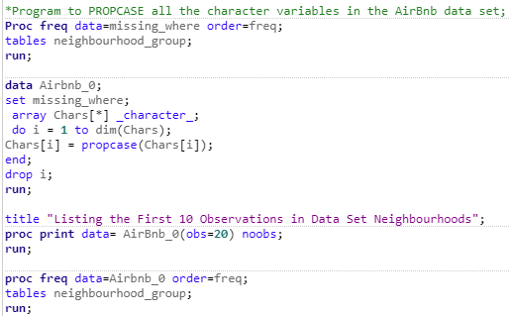
Result
Prop case is used to correct the error where, “brooklyn” was changed to “Brooklyn”.

Slide 29
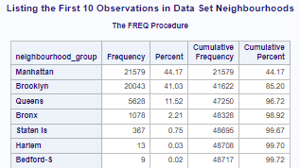
Result

Slide 30
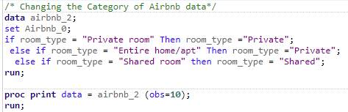
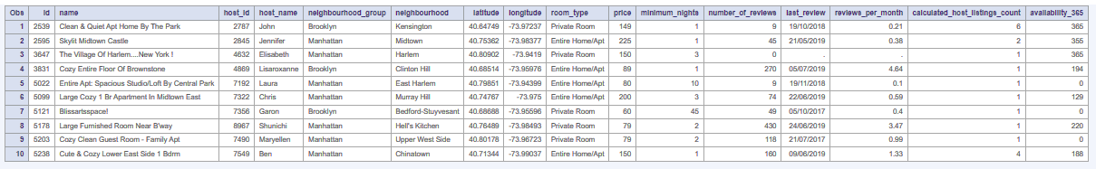
Categorizing the room type

Slide 31
THANK YOU

